Slide 1
ORGANIZATIONAL DEVELOPMENT PACKAGE
1

Slide 2
WCO CB Program
Diagnostic
Gap analysis
125
Phase 2
Phase 3
Phase 1
Strategy
Action plan
2012/3: 462
2013: 590
413 Experts
M&E
”Stock-take”
5 missions

Slide 3
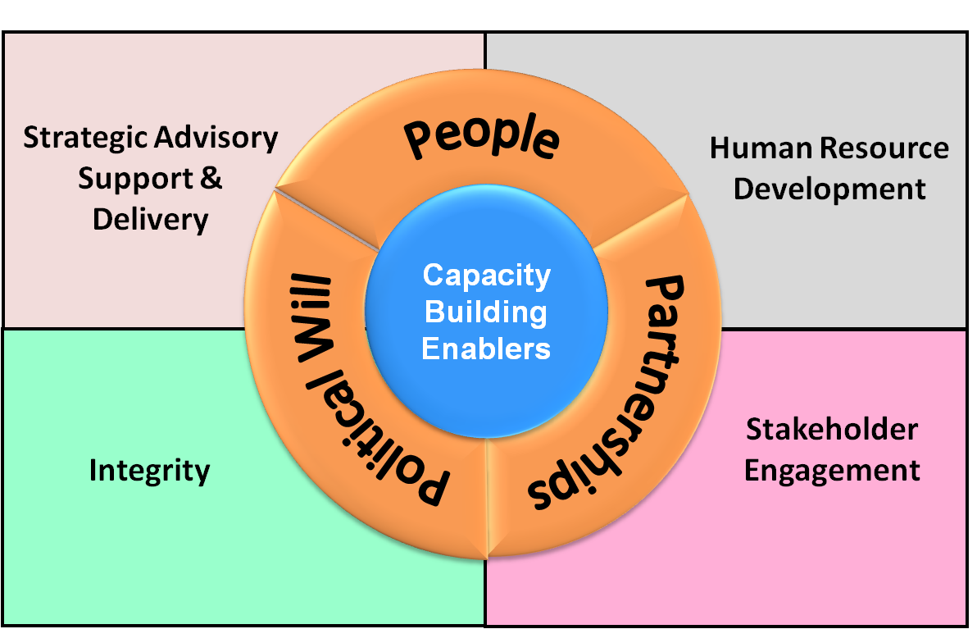
ODP: 3P’s + Overview

Slide 4
ODP: Sections 1 + 2
Strategic, Advisory Support
HRD
LMD, Fellowship, Career Development
Professionalism Framework
CB Strategy + Delivery Program
PICARD
Needs Assessment
E-Learning + CLIKC!
Diagnostic Framework + Compendium
Progress Reports + Case Studies
4

Slide 5
ODP: Sections 3 + 4
Integrity
Stakeholder Engagement
Regional Donor Engagement
Project Map Database
Revised Arusha Declaration
Orientation Package
IDG + Model Code of Conduct
Resource mobilization support
Newsletter
Project support
5

Slide 6
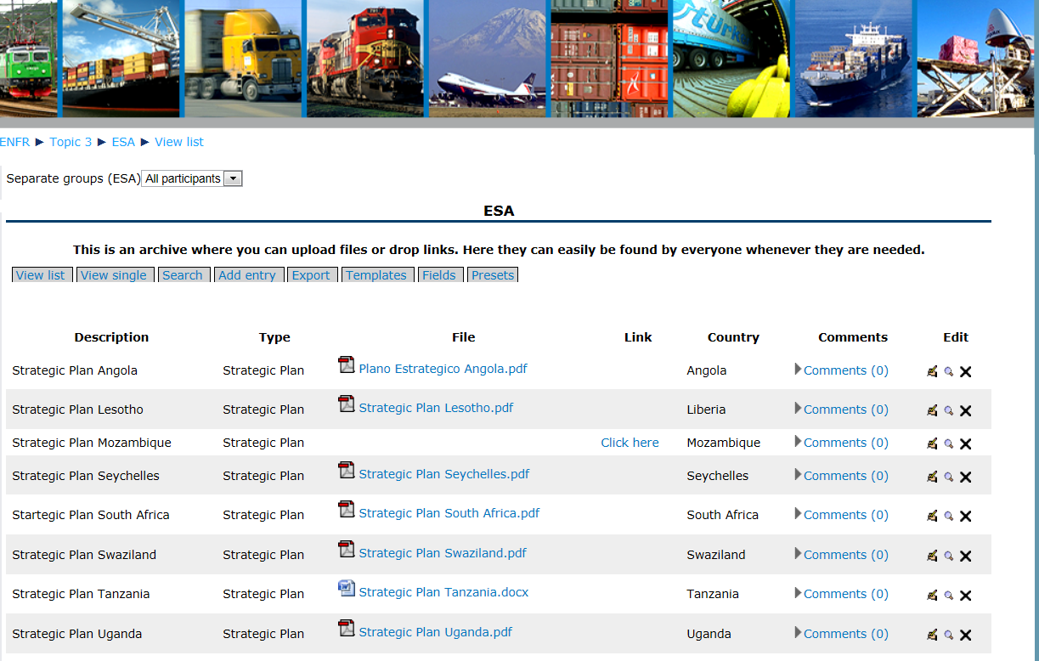
Strategic Planning - CLiKC! Platform
Copyright © WCO-OMD 2013
6

Slide 7
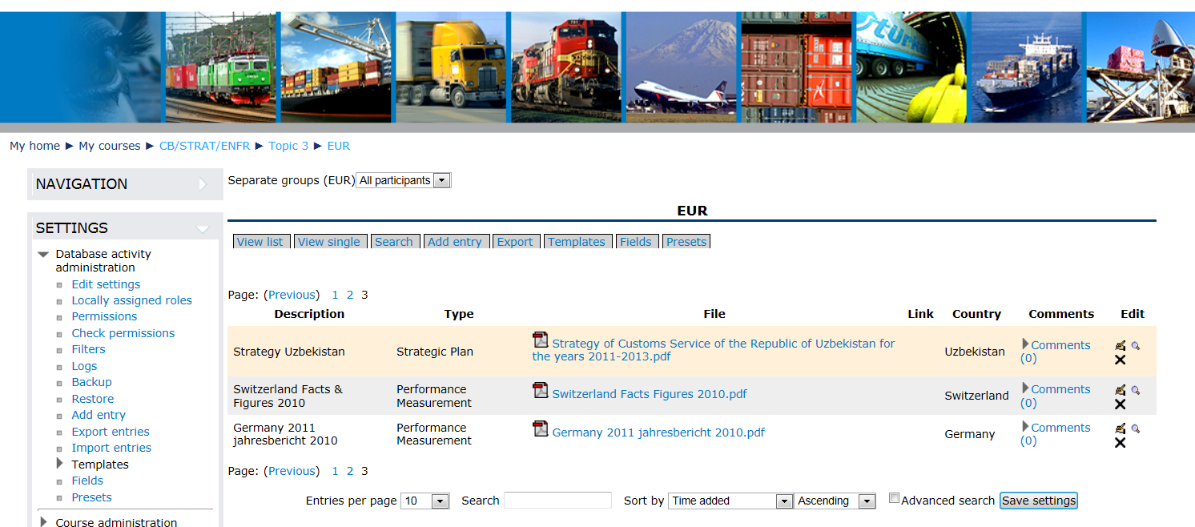
Performance Measurement - CLiKC! Platform
Copyright © WCO-OMD 2013
7

