Slide 1
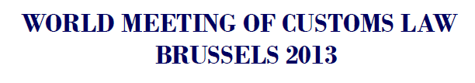
THE SAFE FRAMEWORK AND THE AUTHORIZED ECONOMIC OPERATOR (AEO): EVOLUTION TOWARDS A CONVENTIONAL
REGULATORY STANDARD?
Bryce Blegen
September 5, 2013

Slide 2

C-TPAT to AEO in 2013:
Does 10 Years of Evolution = Progress?

Slide 3
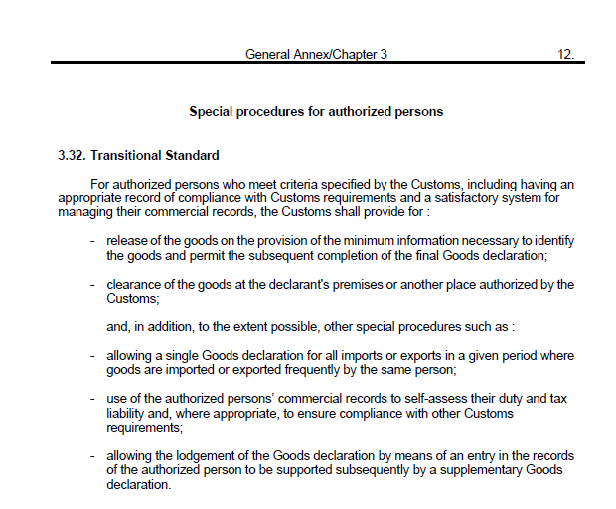
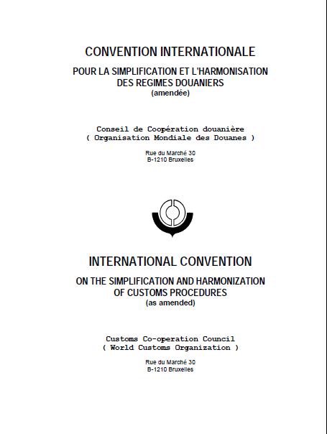
Remember When?
Revised Kyoto Convention: Authorized Person

Slide 4
SAFE Framework Evolution
SAFE Framework developed in 2005 on model of 2003 US post 9/11 “Customs-Trade Partnership Against Terrorism—C-TPAT”; amended in 2007, 2011, and 2012 by recommendation of the SAFE Working Group & WCO Council
Voluntary: Non-binding on signatories
Definition of “Security” much broader than under C-TPAT and has become broader over the years
Expansion of focus from containers to all cargo and conveyances in all modes

Slide 5
SAFE Framework of Standards 2012: Risk Target
“High risk cargo is that for which there is inadequate information or reason to deem it as low risk,
that tactical intelligence indicates as high risk,
or that a risk-scoring assessment
methodology based on security-related data elements identifies as high risk.”

Slide 6
SAFE Framework of Standards 2012:
Definition of AEO
AEO is a party involved in the international movement of goods in whatever function that has been approved by or on behalf of a national Customs administration as complying with WCO or equivalent supply chain security standards. AEOs may include manufacturers, importers, exporters, brokers, carriers, consolidators, intermediaries, ports, airports, terminal operators, integrated operators, warehouses, distributors and freight forwarders.

Slide 7
What Does It Take to be an AEO?
General Pre-Requisites (SAFE Framework 2012):
Demonstrated Compliance with Customs Requirements
Satisfactory System for Management of Commercial Records
Financial Viability
Consultation, Co-operation and Communication with Customs
Staff Education, Training and Awareness
Information Exchange, Access (by Customs) and Confidentiality (from Customs)
Crisis Management and Incident Recovery Contingency Planning
Commitment to Monitoring & Reporting
Security Pre-Requisites (C-TPAT & SAFE Framework 2012):
Cargo Security
Conveyance Security
Premises Security
Personnel Security
Trading Partner Security
Continuous Measurement, Analysis and Improvement

Slide 8
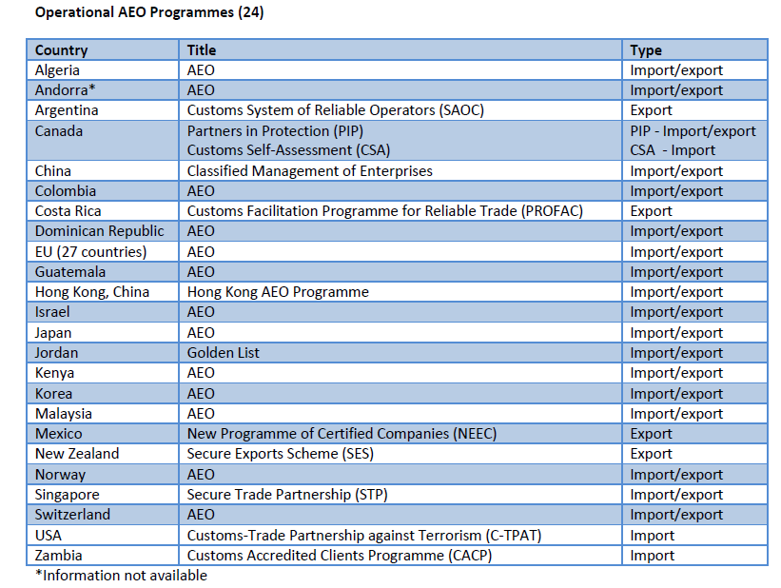
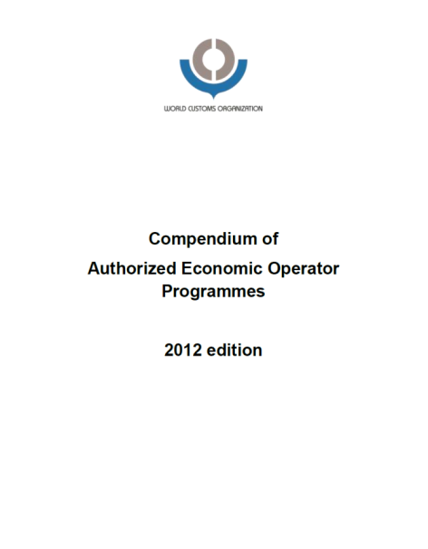
AEO Global Expansion

Slide 9
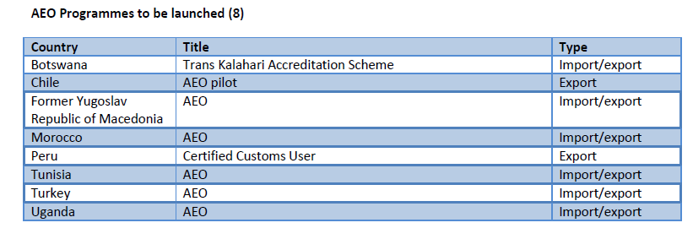
AEO Global Expansion

Slide 10
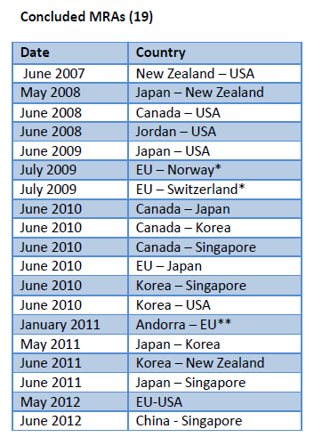

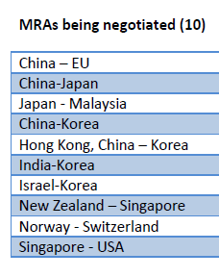
Mutual Recognition Arrangements

Slide 11



Mutual Recognition Implementation
Benefits for AEO to AEO Consignments:
US Inbound Consignments from Japan and EU AEOs:
U.S. Importer – No Overseas Supplier Validation Visit / Faster Validation/Re-Validation Process for US C-TPAT member
AEO Supplier: inbound consignment receives a lower risk score/quicker clearance
Japan Inbound Consignments:
Export consignments from US & EU AEOs eligible for low-risk import status if AEO registered with Japan Customs
EU Inbound Consignments:
EU phasing in risk targeting reductions for import consignments exported by US C-TPAT and Japan AEO members

Slide 12
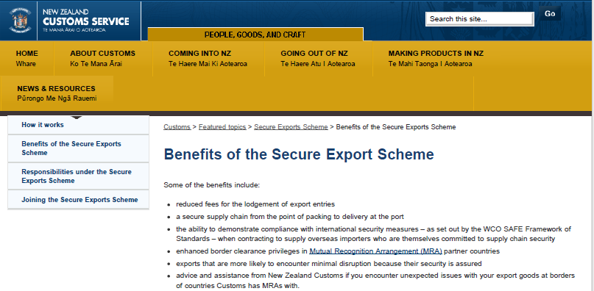
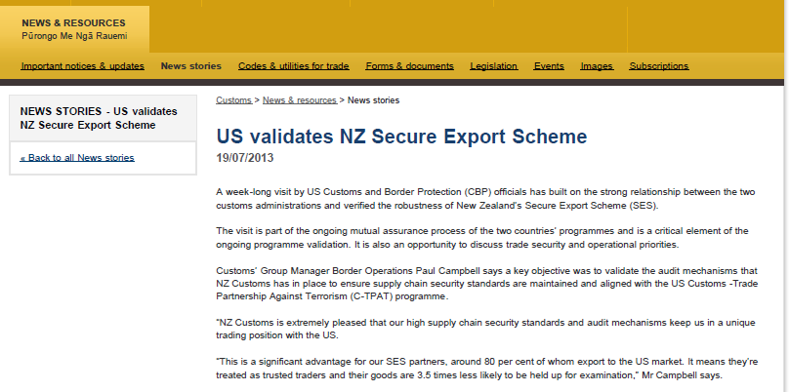
Benefits of MR in Practice: NZ-US

Slide 13
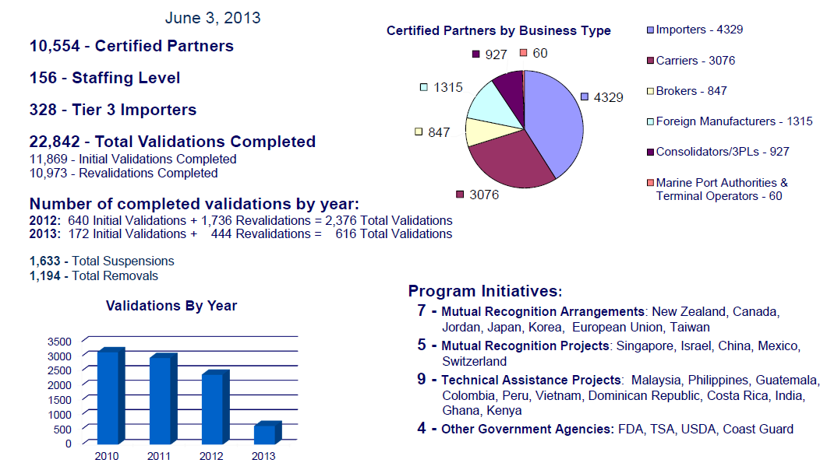
US C-TPAT Ten Years On: Key Data 2013

Slide 14

Enabling Trade 2013: What About Small & Medium Sized Enterprises?
“Today, trade facilitation measures such as authorized economic operators or trusted trader programmes generally target large traders and shippers. It is important that such initiatives to reduce regulatory compliance costs be complemented by programmes and solutions for SMEs to help them address regulatory complexity and lower their costs.”

Slide 15
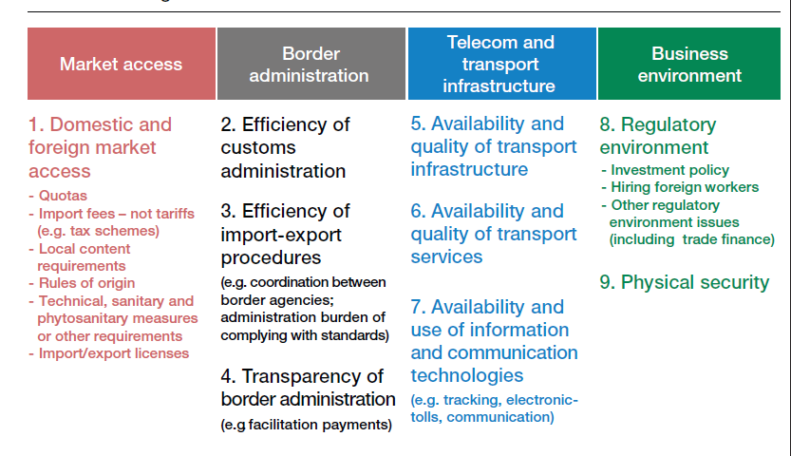
Enabling Trade 2013: Supply Chain Barriers to Trade

Slide 16

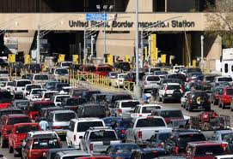



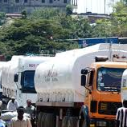
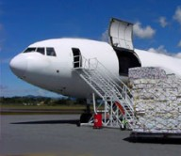

International Trade in the 20th Century
Importer
National Border
Exporter
Notes:
16
AWA AUSSENWIRTSCHAFTS-AKADEMIE
16
AWA AUSSENWIRTSCHAFTS-AKADEMIE

Slide 17



International Trade in the 21st Century
Phytosanitary
Approval
Importer
National Border
Phytosanitary
Approval
Exporter
Notes:
17
AWA AUSSENWIRTSCHAFTS-AKADEMIE
17
AWA AUSSENWIRTSCHAFTS-AKADEMIE

Slide 18
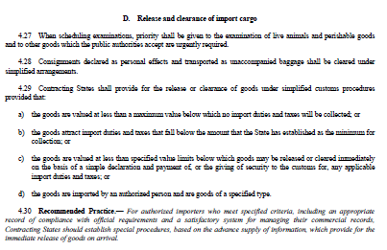
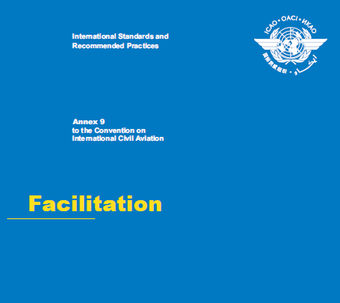
ICAO: Chicago Convention:
Authorized Importer to AEO?
Air Cargo governed by binding international treaty: Convention on International Civil Aviation (“Chicago Convention”); administered by International Civil Aviation Organization (ICAO)
Chicago Convention amended to enhance air cargo security and further amendments to Annex 9 planned
WCO and ICAO working together to harmonize SAFE initiatives (e.g. AEO, advance data) and ICAO security programs (Regulated Agent/Known Consignor—Annex 17)

Slide 19
Air Cargo Security Concept

Slide 20
Air Cargo: Aircraft Operator Screening

Slide 21
Air Cargo: Regulated Agent Screening

Slide 22
Air Cargo: Known Consignor in Secure Supply Chain

Slide 23
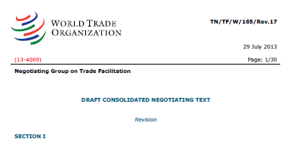
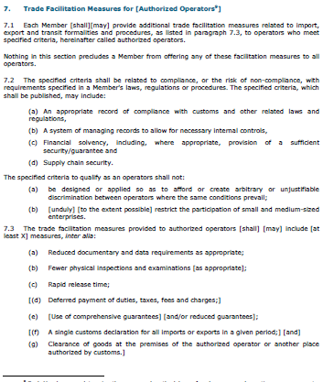
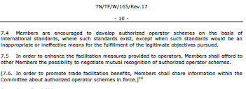
WTO: Hope on the Horizon?

Slide 24
The Way Forward on AEO—A Few Recommendations (Part 1)
The AEO concept must be grounded in one or more binding international treaties/conventions, such as an amended RKC, a new WTO TF Agreement, or both, mandating use of the same qualification criteria, categories of benefits, and mutual recognition effects.
AEO status certified under a national program meeting the SAFE Framework security criteria should be recognized as equivalent to meeting security requirements in parallel known consignor/regulated agent programs set up under ICAO auspices (ICAO instruments must be harmonized with concepts in the legal instruments noted above).

Slide 25
The Way Forward on AEO—A Few Recommendations (Part 2)
As in the ICAO regulated agent concept, qualified service providers with AEO status and validated security procedures should be able to grant “low-risk” status to consignments in land and sea modes handled by them and moving in a secure supply chain environment.
AEO and similar programs must be tailored to enable flexible means of ensuring low-cost SME access to the international supply chain, while maintaining an acceptable level of security—focus should be on “enabling and encouraging” SME traders, not just prohibiting “undue restrictions” on them.

Slide 26

THANK YOU FOR YOUR ATTENTION!

